Slide 1
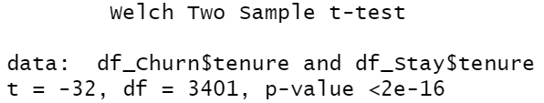
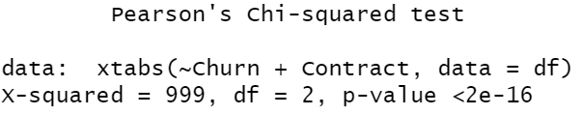




Logistic Regression

Slide 2
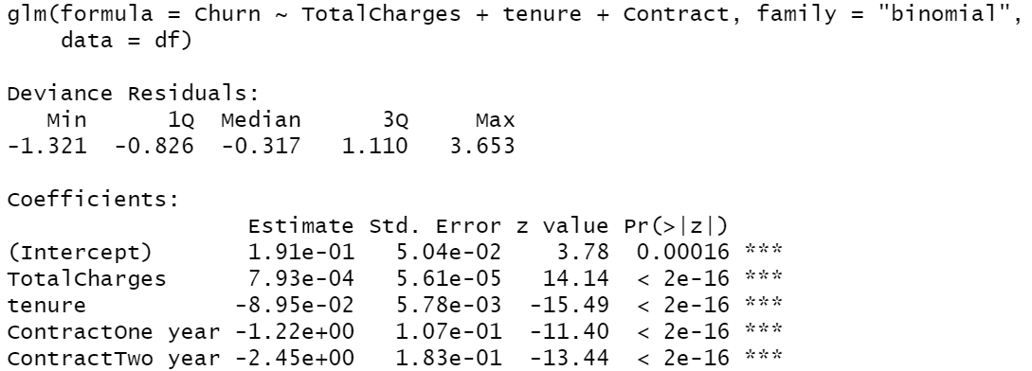
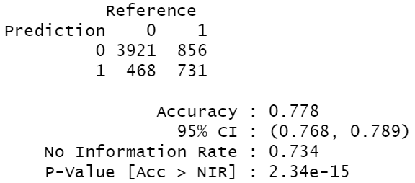
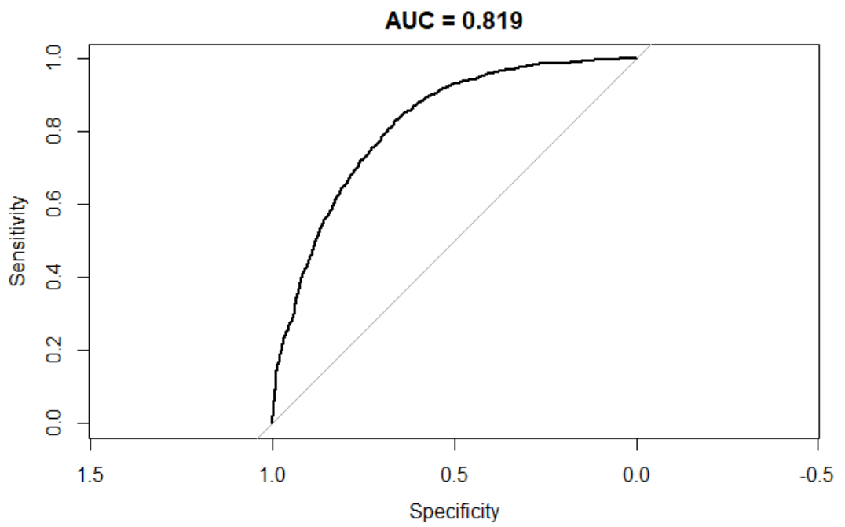
Logistic Regression
Long term customer have better loyalty.
Look for False Negative
Pseudo R²: 0.217

Slide 3
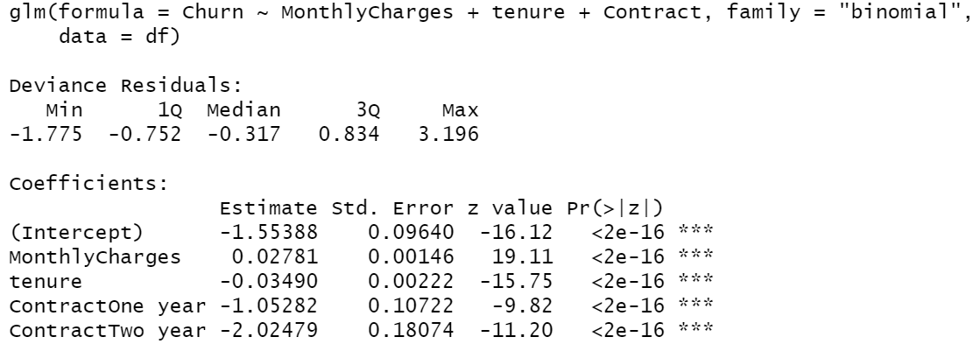
Logistic Regression
Use Monthly Charges as predictor is much easier to interpret, since people are likely to be more sensitive to marginal cost. But may hurt model accuracy in bigger models.
Prediction Accuracy vs. Interpretability

Slide 4
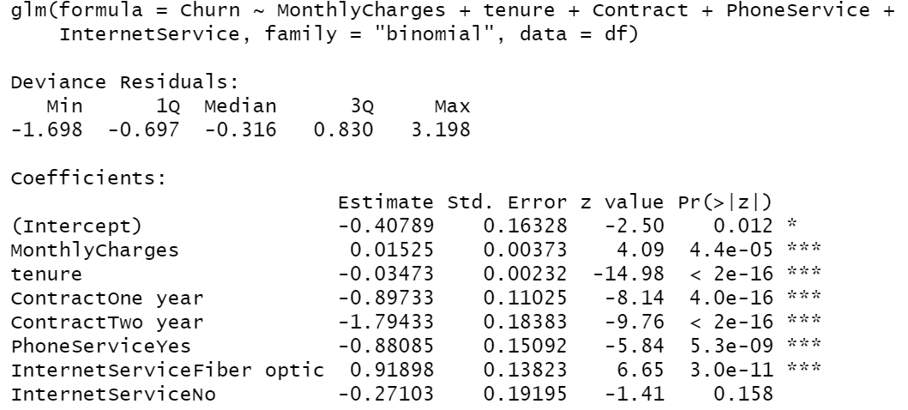
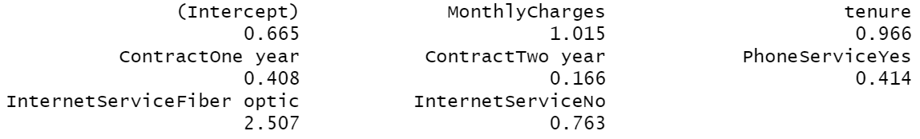
Logistic Regression
Good Job to Phone Dpt. & Investigate Internet Service Dpt. Now!
Highly likely due to overpricing of Fiber Optic connection compared with competition.

Slide 5
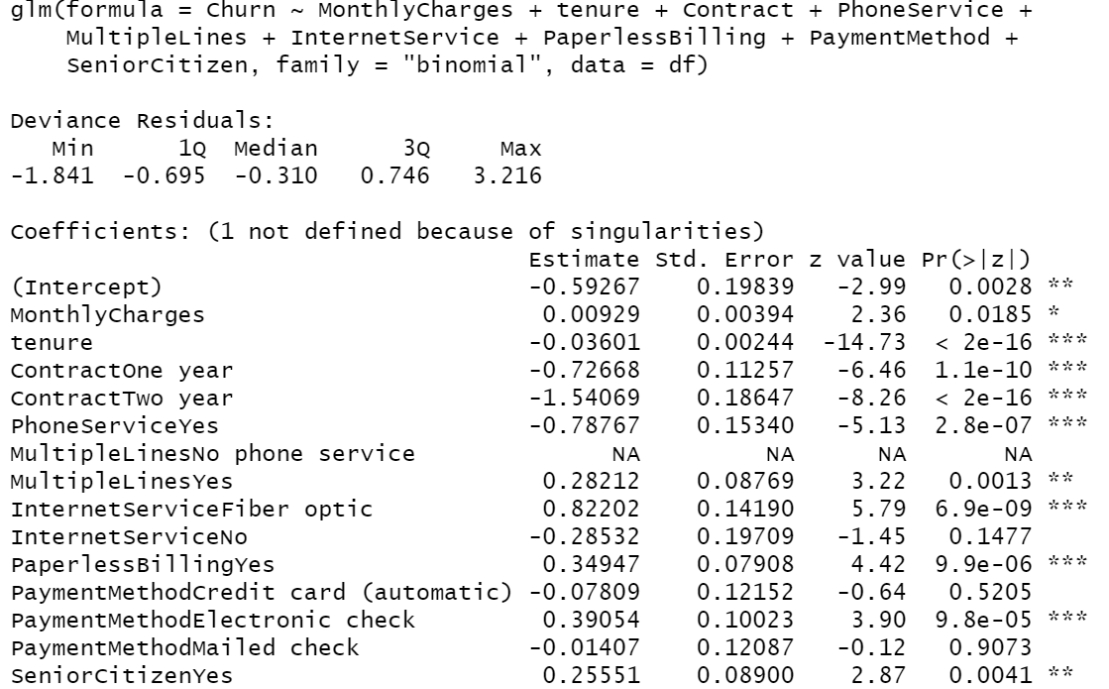
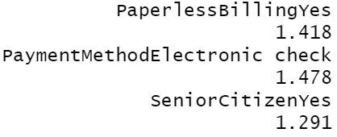
Logistic Regression
Pseudo R²: 0.269
AUC: 0.838
Accuracy: 0.8
False Negative: 755
Provide Discount to App users and Seniors

Slide 6
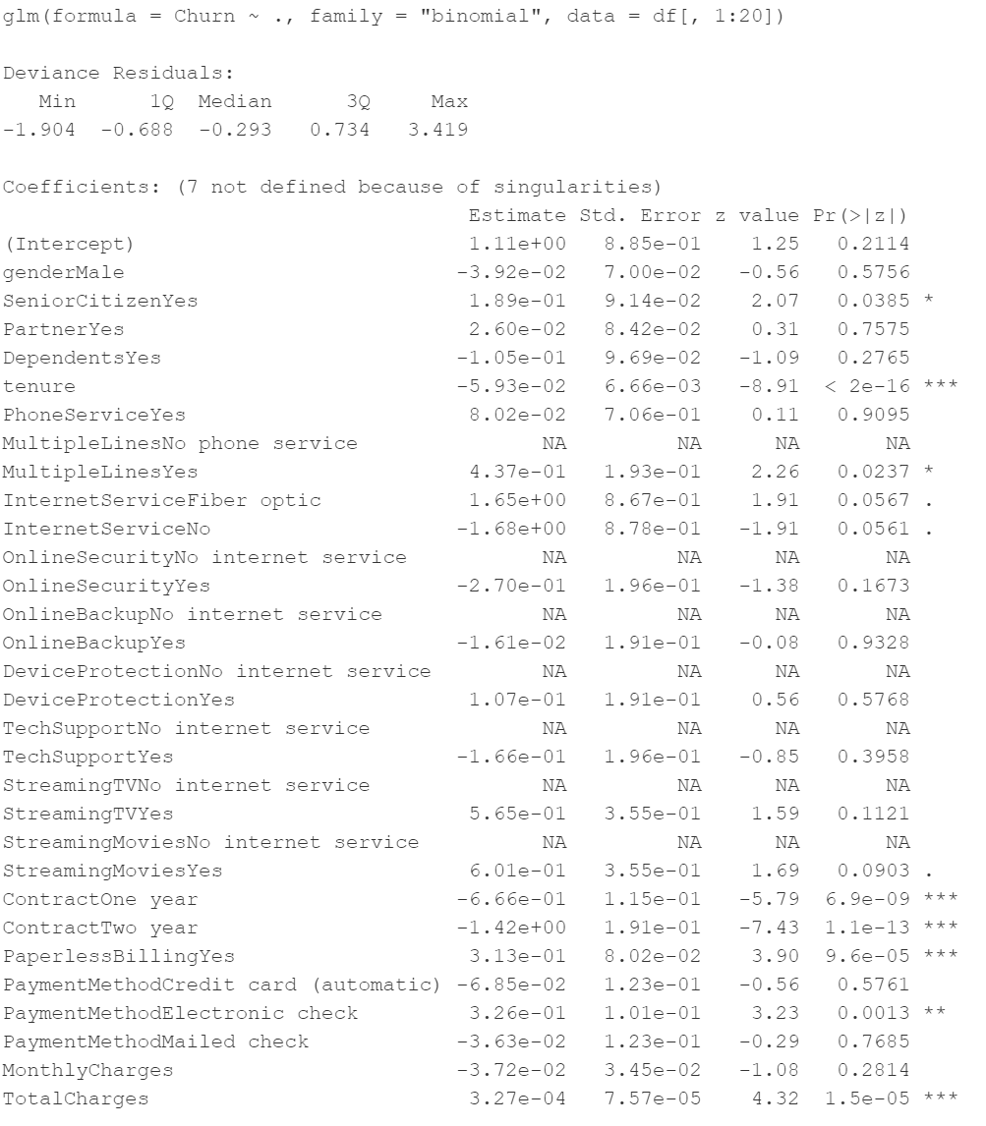
Logistic Regression
Full Model:
Pseudo R²: 0.279
AUC: 0.845
Accuracy: 0.804
False Negative: 724
Full model improves prediction accuracy and False Negative rates, improves pseudo R² and AUC, but harms interpretation.

